Slide 1
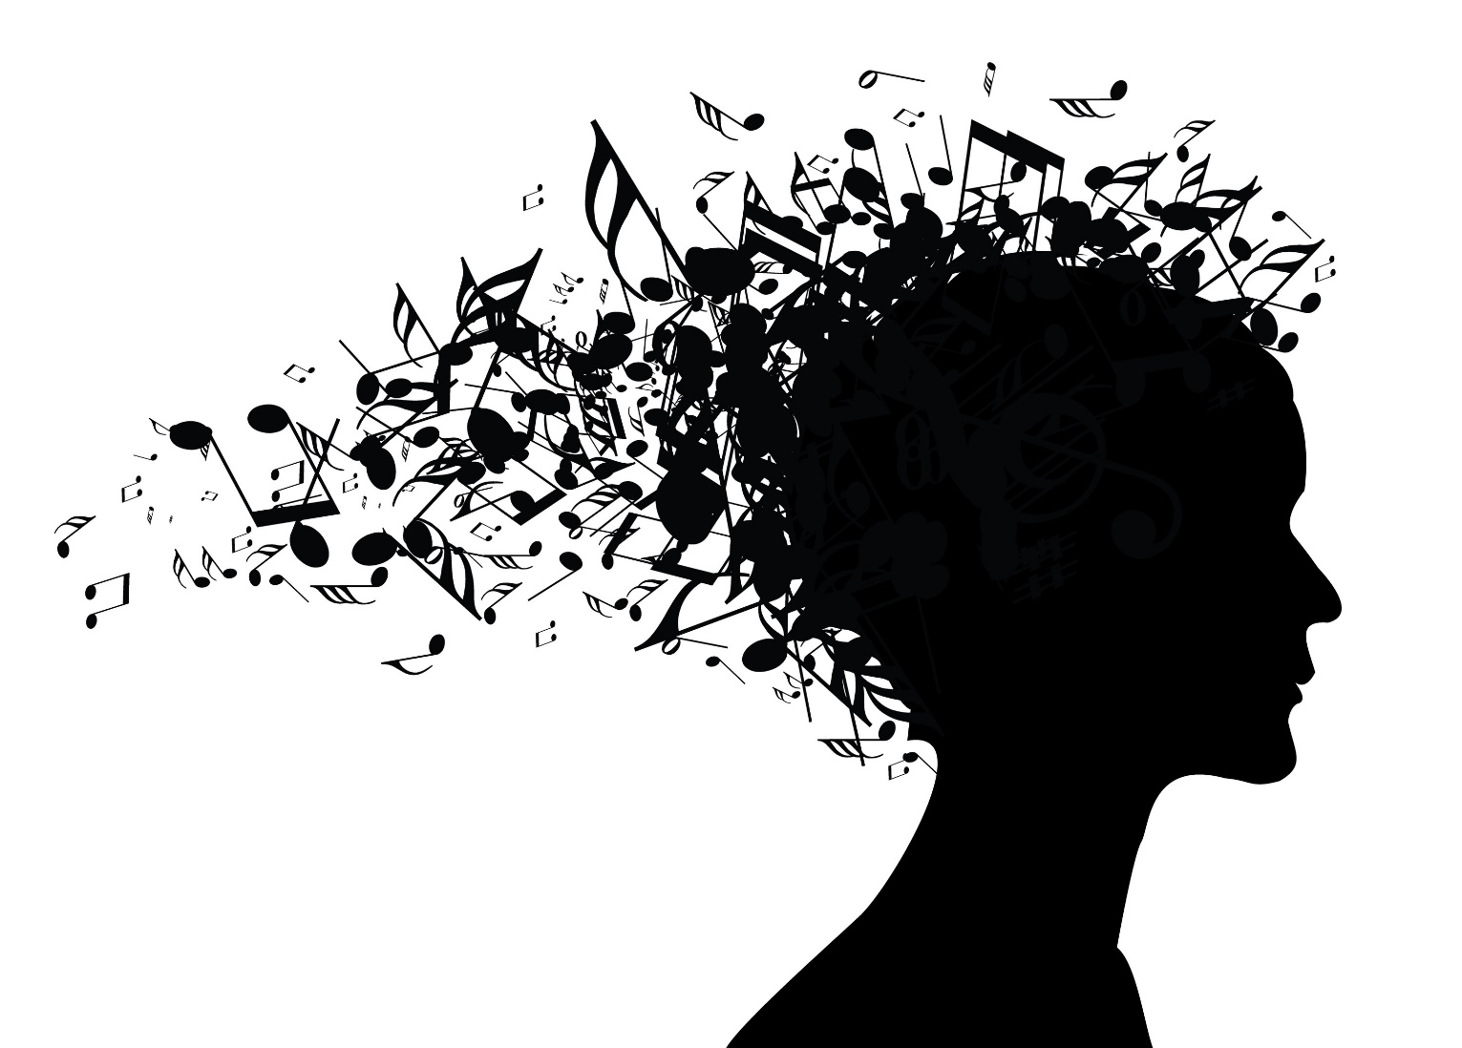
Generating music with LSTM
MSBA7011 Managing and Mining Big Data Audiophile

Slide 2

Objective
Data
Modeling
Results
Conclusion
Appendix

Slide 3
Objective
Pick one artist, and use his songs as training data
Generate new music using LSTM model.
The model should generate new music in the style of that artist
Our goal:

Slide 4
Objective
Data
Modeling
Results
Conclusion
Appendix

Slide 5
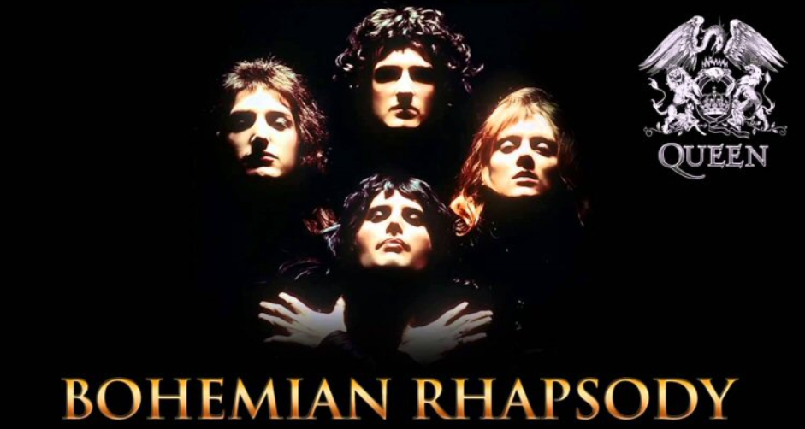
Data
Queen
One of the most famous band in the world. Members: Freddie Mercury, Brian May, Roger Taylor, John Deacon

Slide 6
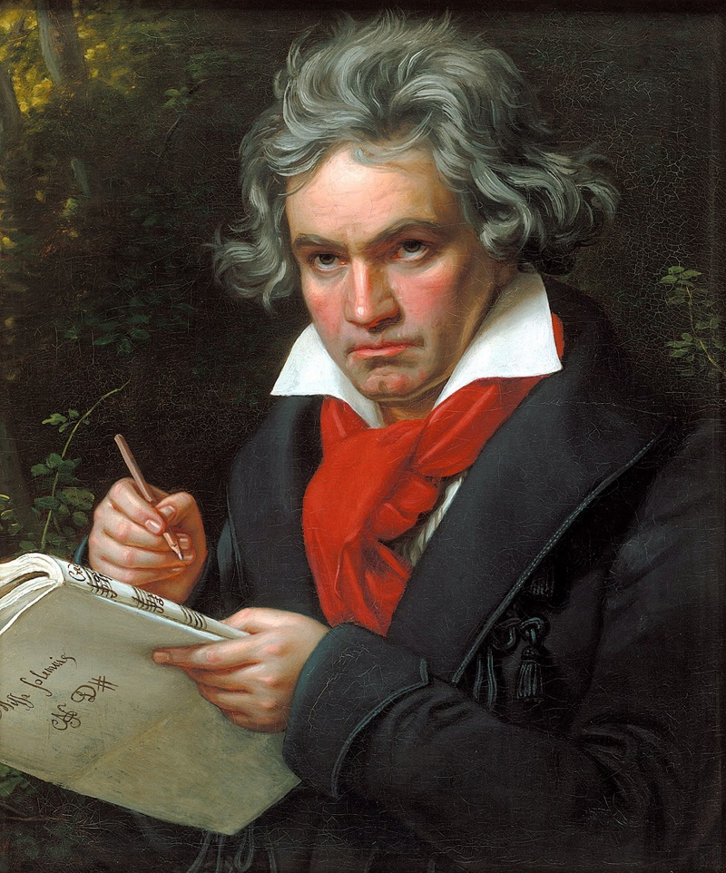
Data
Ludwig van Beethoven
Composer and Pianist The man and the artist, as revealed in his own words

Slide 7
Objective
Data
Modeling
Results
Conclusion
Appendix

Slide 8
Process
Modeling
Convert music information into numerical data (music21)
Notes, chords, pitch, octave, offsets, rest, instruments, etc.
Define starting point and ending objective
Input: sets of sequence of 100 notes/chords
Output: 500 notes/chords
Train RNN with LSTM
Predominantly 2 layers (due to time)
Generate music with RNN
Set random note to start
Notes:
Make dictionary of where keys = notes and value = numerical value that represents the key
Sequence = 100 because instruments are relatively repetitive (for queen and Beethoven) (enough/ lack of domain knowledge)
Normalize input, and one-hot encode output

Slide 9
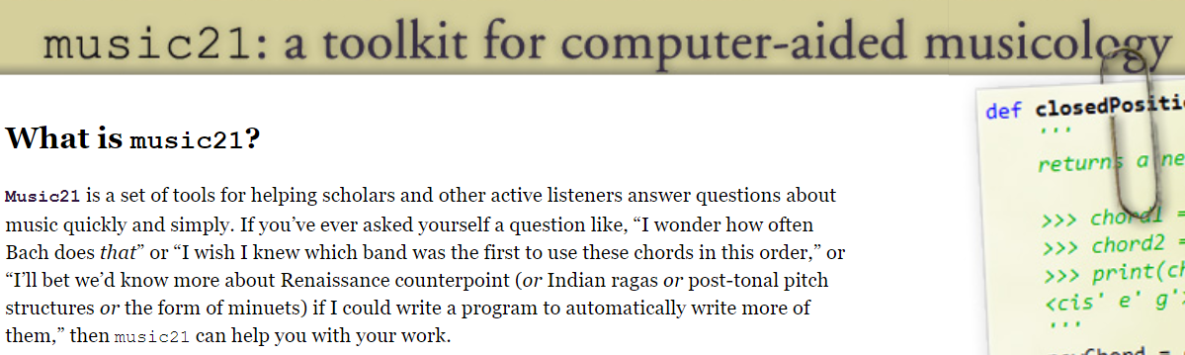
Data
music21
The package we use to handle music data

Slide 10
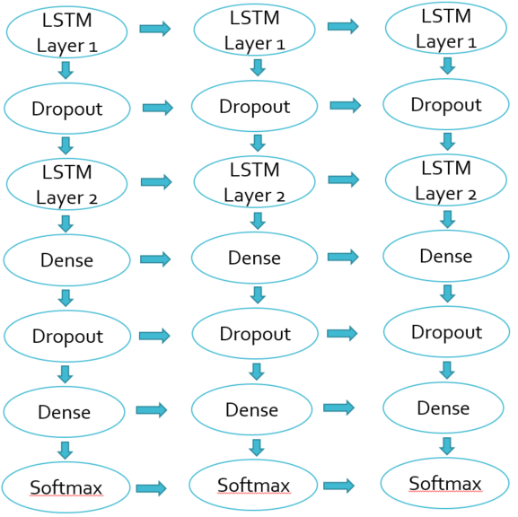
Two Layer Architecture
Modeling
Softmax
Softmax
Softmax

Slide 11
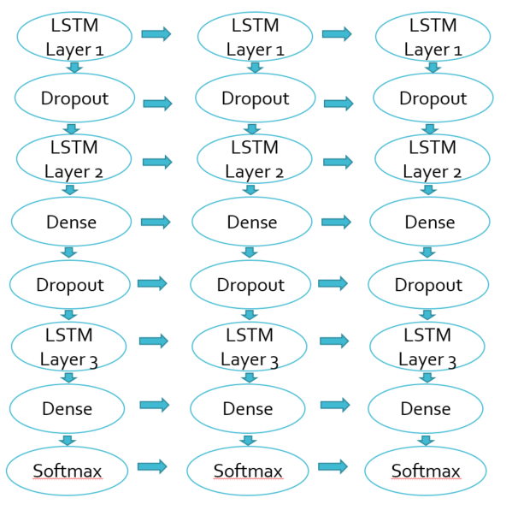
Three Layer Architecture
Modeling
Softmax
Softmax
Softmax

Slide 12
Objective
Data
Modeling
Results
Conclusion
Appendix

Slide 13
Results
Queen’s
results:
2 Layers
Full Midi File
The outcome will be a piano piece based on all the instruments used in the songs

Slide 14

10 epochs was not enough…
Results - Queen
Notes:
Make dictionary of where keys = notes and value = numerical value that represents the key
Sequence = 100 because instruments are relatively repetitive (for queen and Beethoven) (enough/ lack of domain knowledge)
Normalize input, and one-hot encode output

Slide 15
40 epochs yielded more than one note…
Results - Queen
Notes:
Make dictionary of where keys = notes and value = numerical value that represents the key
Sequence = 100 because instruments are relatively repetitive (for queen and Beethoven) (enough/ lack of domain knowledge)
Normalize input, and one-hot encode output

Slide 16
100 epochs becomes more complex…
Results - Queen
Notes:
Make dictionary of where keys = notes and value = numerical value that represents the key
Sequence = 100 because instruments are relatively repetitive (for queen and Beethoven) (enough/ lack of domain knowledge)
Normalize input, and one-hot encode output

Slide 17
Results
Beethoven
results:
2 Layers
Pure piano input
Changed tempo (200 epoch)
The model is writing a piano piece based on other piano pieces

Slide 18
100 epochs…
Results - Beethoven
Notes:
Make dictionary of where keys = notes and value = numerical value that represents the key
Sequence = 100 because instruments are relatively repetitive (for queen and Beethoven) (enough/ lack of domain knowledge)
Normalize input, and one-hot encode output

Slide 19
200 epochs with manual change in tempo…
Results - Beethoven
Notes:
Make dictionary of where keys = notes and value = numerical value that represents the key
Sequence = 100 because instruments are relatively repetitive (for queen and Beethoven) (enough/ lack of domain knowledge)
Normalize input, and one-hot encode output

Slide 20
Objective
Data
Modeling
Results
Conclusion
Appendix

Slide 21
Reflection:
Conclusion
Data processing is key
Identify parts of music
Identify role of instrument
Consider the type of music
Notes:
1. timing, and rhythm and one instrument
Normalize input, and one-hot encode output
2. Chorus, verse, etc.
3.

Slide 22
Future Improvements
Conclusion
Generative Adversarial Networks (GAN)
Implementation of rhythm
Incorporate more instruments
Reinforcement learning
Separate models for unique genres
Notes:
Make dictionary of where keys = notes and value = numerical value that represents the key
Sequence = 100 because instruments are relatively repetitive (for queen and Beethoven) (enough/ lack of domain knowledge)
Normalize input, and one-hot encode output

Slide 23
Application
Conclusion
Background music generator
Game music
Stock music
Store Music
Assisted creativity
Notes:
Make dictionary of where keys = notes and value = numerical value that represents the key
Sequence = 100 because instruments are relatively repetitive (for queen and Beethoven) (enough/ lack of domain knowledge)
Normalize input, and one-hot encode output

Slide 24
WORKING AGENDA
Revival of Queen/Freddy Mercury
Data Collecting/Cleaning
Methodology/Architecture
Trial 1 (1, 10, 40 epochs) loss > 2, basic patterns and repetition
Trial 2 (Queen 100 epoch) loss 0.3
Trial 2.5 (Beethoven 100 epoch) loss 0.2
Trial 3 (100 epoch Queen piano and bass only vectors 3 layers) loss 0.5
Trial 3.5 (Beethoven 200 epoch vs Queen 200 epoch)
Trial 4 Adding rhythm
Reflection
Future improvement (rhythm, more instruments, consistent music)
Piano can be main or background music
Combining all, pop music would not be an issue

Slide 25
Objective
Data
Modeling
Results
Conclusion
Appendix

Slide 26
Work Cited
Appendix
http://www.piano-midi.de/beeth.htm
http://tomqueen.tripod.com/midis.html
https://towardsdatascience.com/how-to-generate-music-using-a-lstm-neural-network-in-keras-68786834d4c5
https://blog.floydhub.com/generating-classical-music-with-neural-networks/
https://www.google.com/url?sa=t&rct=j&q=&esrc=s&source=web&cd=2&cad=rja&uact=8&ved=2ahUKEwiVvqKO6-zgAhXOdN4KHUVgD1QQFjABegQIGxAC&url=https%3A%2F%2Farxiv.org%2Fpdf%2F1804.07300&usg=AOvVaw2Jxr__aIttKMfzfpzQRgf3
https://medium.com/datadriveninvestor/music-generation-using-deep-learning-85010fb982e2

Slide 27
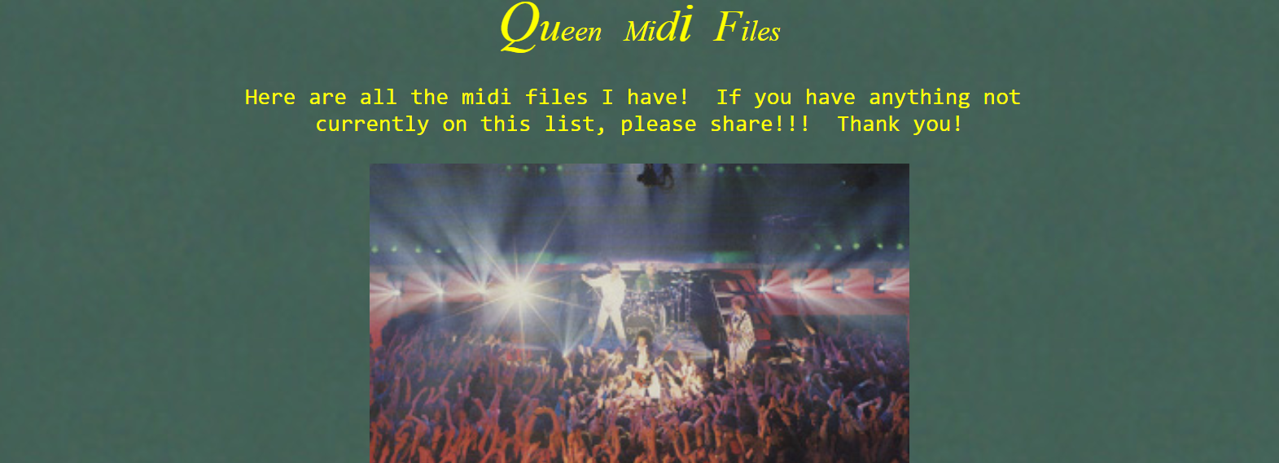
Appendix
We download data from:
http://tomqueen.tripod.com/midis.html Use 11x Queen’s midi songs as input data

